Slide 1
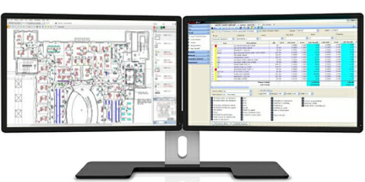
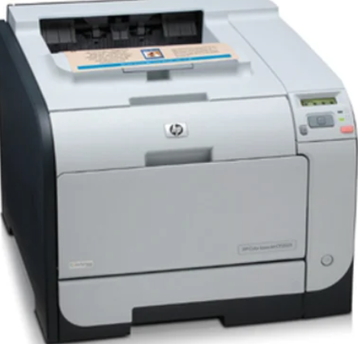
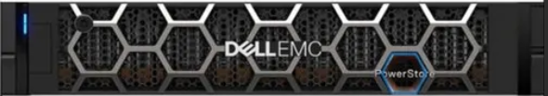
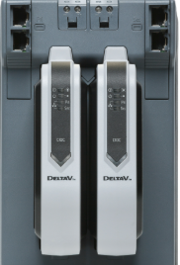
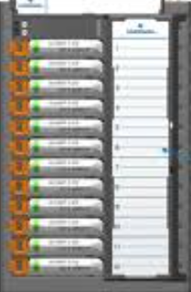
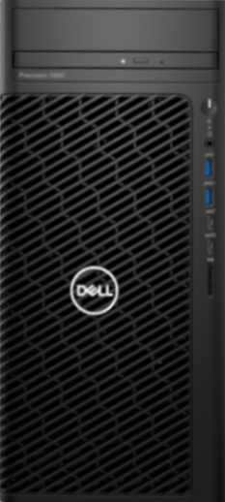

CO2 Capture Plant
PDC ROOM
OPERATOR ROOM
Analog Monitor Input 225 D | Analog Control Output 50 D | Discrete Monitor Input 125 | Discrete Control Output 75 | System Softkey | Sytech Reporter
OWS
ProfessionalPLUS Premium WS Soft...
PK Controller
CIOC 1
CIOC 2
CIOC 3
Printer
Rack WS Win10 Ent RAID1 16GB RAM
x36 Dual Single Mode Media Converter...
CIOC 1
CIOC 2
CIOC 3
Smart Switch 19-inch Rack mount ...
19inch rack mounted sliding screen
APC UPS
8/8
8/8
8/8
x8 Fiber optic cable 5 mtr
Hirschmann 8-port rack mount swi...
8/8
8/8
5/8
21/24 baseplates · 3 CIOC towers
24/24 baseplates · 3 CIOC towers
Server Cabinet
I/O Cabinet #1
I/O Cabinet #2
OWS Tower
FOPP DIN mount
FOPP
FOPP
FOPP
LEGEND
PK Controller
UPS
CIOC
Fiber / FOPP
CHARM I/O
Network
EWS / WS
Software
Switch
Power

